Slide 1

Information Visualization for Agile Software Development Teams

Slide 2

Knowledge management
The objectives of knowledge management (KM) is to improve productivity by effective knowledge sharing and transfer.
Agile software development has put a new focus on the question of how to share knowledge among members of software development teams.
In contrast to heavy-weight, document-centric approaches, agile approaches rely on face-to-face communication for knowledge transfer.
Pair programming is one such practice with the idea to share the work specific knowledge across the development teams through pair rotation.
Understanding information about software artifacts is key to successful Agile software development projects; however, sharing information about artifacts is difficult to achieve amongst team members.

Slide 3
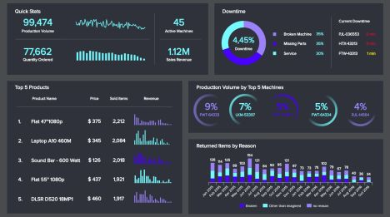
How Visualization is useful for Knowledge management?

Slide 4

Information Visualization
visualization techniques help Agile teams increase knowledge sharing and raise awareness about software artifacts amongst team members.

Slide 5

Our goal
There are many information visualization techniques used to help address the difficulties of knowledge sharing, but it is not clear what is the most effective technique.

Slide 6



Research Method we would like to conduct surveys and interviews with Agile practitioners and compare the obtained results with systematic mapping study that we have performed to know the use of visualization techniques and tools.

Slide 7
Phases
The results of the systematic mapping show that Agile teams use visualization techniques for:
designing - In this phase, we represent the ideas diagrammatically for better understanding of what to do in project.
Developing - in this phase, the developers should have better understanding of designs to develop the required specifications and feedback for their development.
Communicating - In this phase, the co-ordination among the team members about the project is observed.
tracking progress - in this phase, they try to track the progress of the project.

Slide 8
Previously used Visualization tools & techniques
Designing - most prolific techniques are low fidelity sketches (informal drawings that don’t follow a convention) and input diagrams (formal drawings that follow a convention)
Developing - SourceVis and codecity tools support visualizations to explore the structure and evolution of software.
Communicating - FASTDash and Awareness 2.0 are digital visualization tools that help increase awareness of the status of a project and the development process
tracking progress – Kanban and trello tools with help of planning poker technique helps in tracking progress.

Slide 9

Questions:
What information visualization techniques and tools are commonly used in Agile software development?
What information visualization techniques raise awareness of artifacts in Agile software development teams?
What are the benefits, one could acquire using Visualization approach in Knowledge management
What are the challenges that are overcame by Agile software development using visualization approach/techniques in Knowledge management

Slide 10


